Slide 1
Probability and statistics 05 - Continuous Random Variable
상명대학교 휴먼지능정보공학과
2022년 2학기

Slide 2
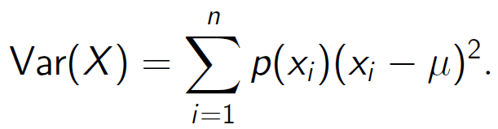

Variance and standard deviation
X a discrete random variable with mean E(X) = μ.
Meaning: spread of probability mass about the mean.
Definition as expectation (weighted sum):
Var(X) = E((X − μ)²).
Computation as sum:
Standard deviation
Units for standard deviation = units of X.

Slide 3
Algebra with variances
If a and b are constants then
Var(aX + b) = a² Var(X).
If X and Y are independent random variables then
Var(X + Y) = Var(X) + Var(Y).

Slide 4
Questions
Prove: if X ∼ Bernoulli(p) then Var(X) = p(1 − p).
Prove: if X ∼ bin(n, p) then Var(X) = n p(1 − p).
Hint:
X=1 if H with probability p, 0 otherwise. E(X)= p.
Use

Slide 5
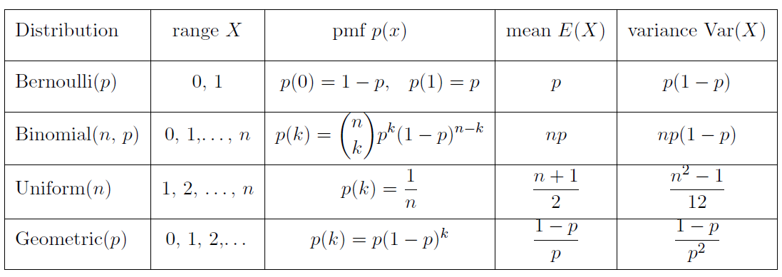
Expected values & Variances

Slide 6
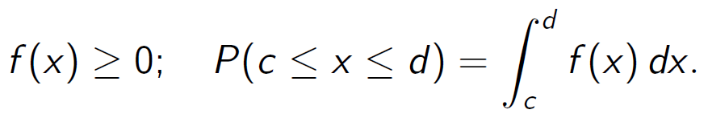
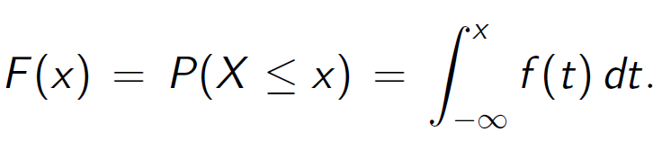
Continuous random variables
Continuous range of values: [0, 1], [a, b], [0,∞), (−∞,∞).
Probability density function (pdf)
Cumulative distribution function (cdf)

Slide 7
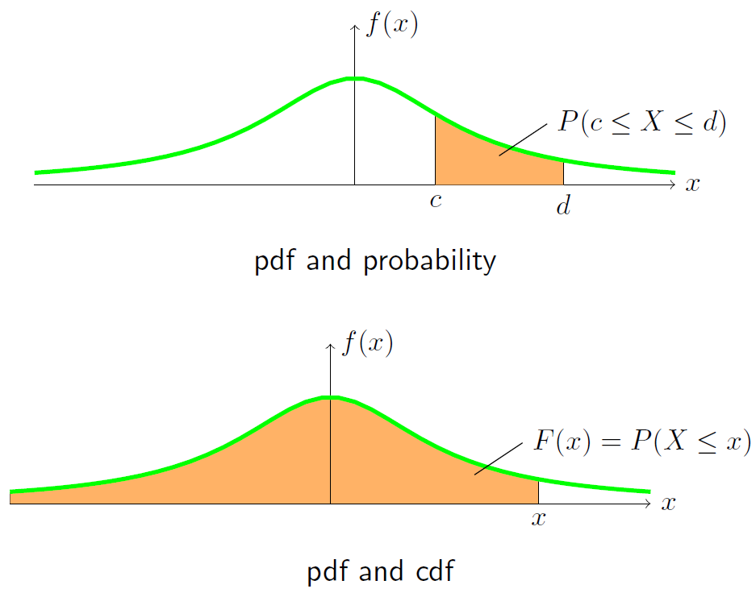

Slide 8
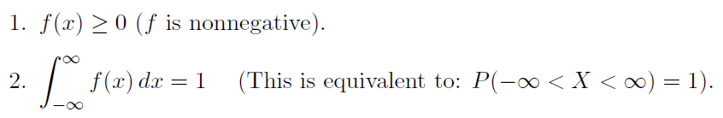
Properties of the pdf & cdf
pdf:
cdf: Definition: F(x) = P(X ≤ x).
0 ≤ F(x) ≤ 1.
non-decreasing.
0 to the left: lim_{x→−∞} F(x) = 0.
1 to the right: lim_{x→∞} F(x) = 1.
P(c < X ≤ d) = F(d) − F(c).
F'(x) = f(x).

Slide 9
Questions
1. Suppose X has range [0, 2] and pdf f (x) = cx.
(a) What is the value of c?
(b) Compute the cdf F(x).
(c) Compute P(1 ≤ X ≤ 2).
2. Suppose Y has range [0, b] and cdf F(y) = y²/9.
(a) What is b?
(b) Find the pdf of Y.

Slide 10
Suppose X is a continuous random variable.
(a) What is P(a ≤ X ≤ a)?
(b) What is P(X = 0)?
(c) Does P(X = a) = 0 mean X never equals a?
answer:
(a) 0
(b) 0
(c) No. For a continuous distribution any single value has probability 0. Only a range of values has non-zero probability.

Slide 11
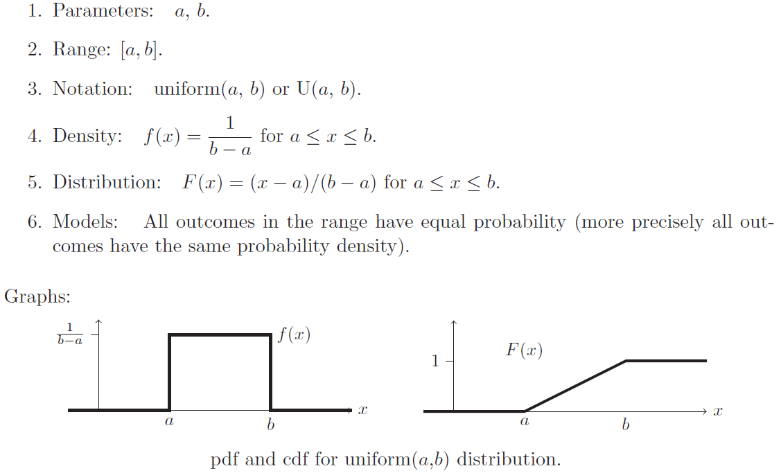
Uniform distribution

Slide 12
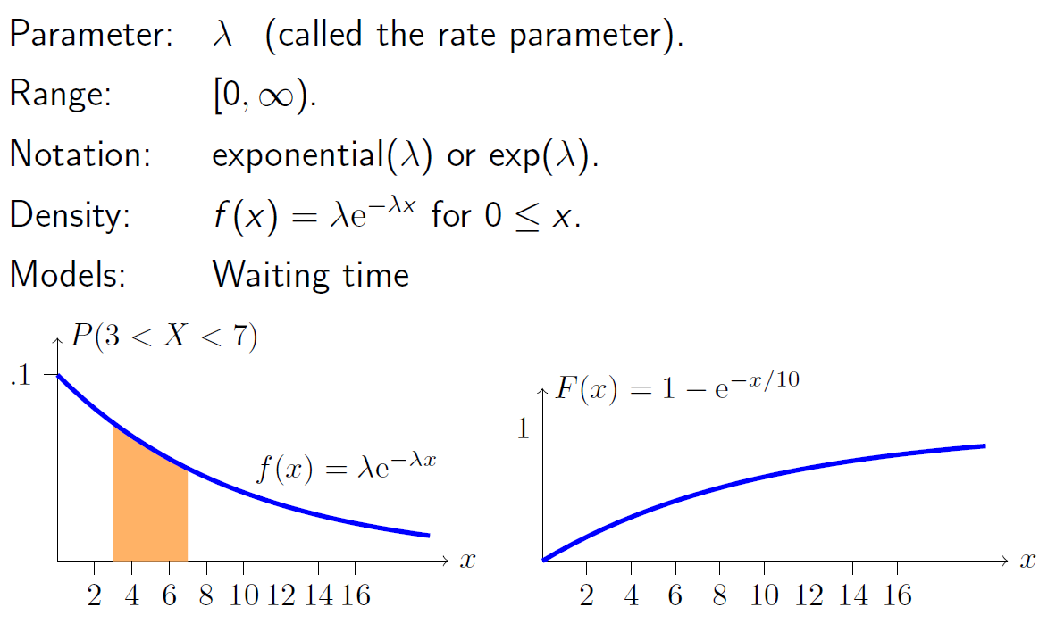
Exponential distribution

Slide 13
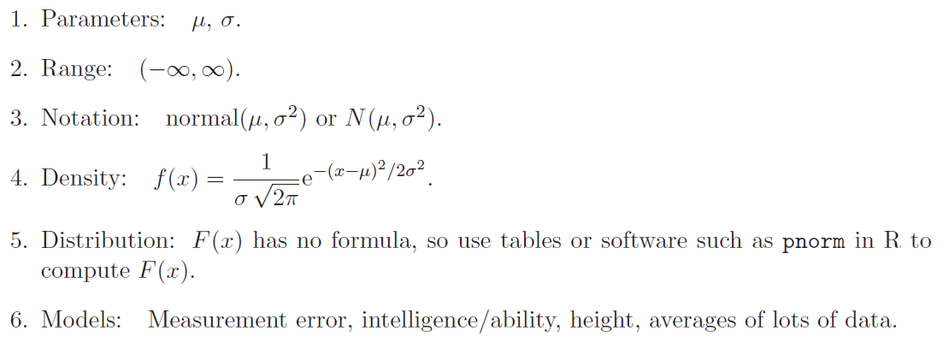
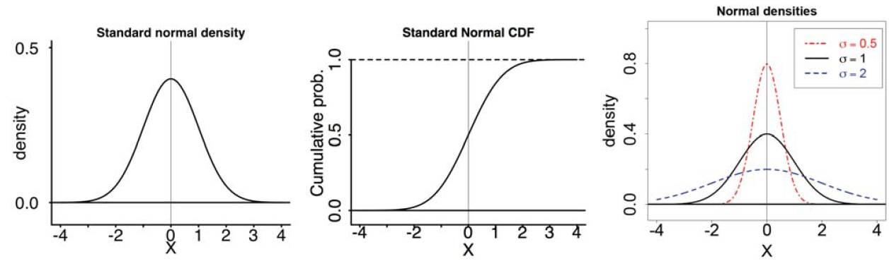
Normal distribution
The standard normal distribution N(0, 1) has mean 0 and variance 1.

Slide 14
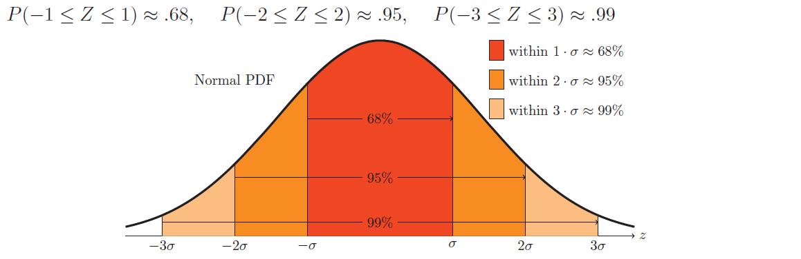
Normal probabilities
To make approximations it is useful to remember the following rule of thumb for three approximate probabilities:

Slide 15
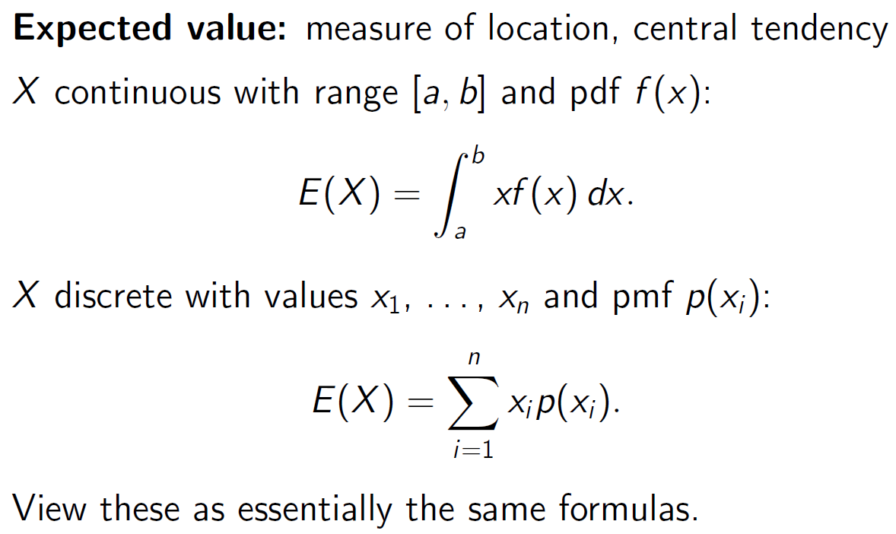

Slide 16
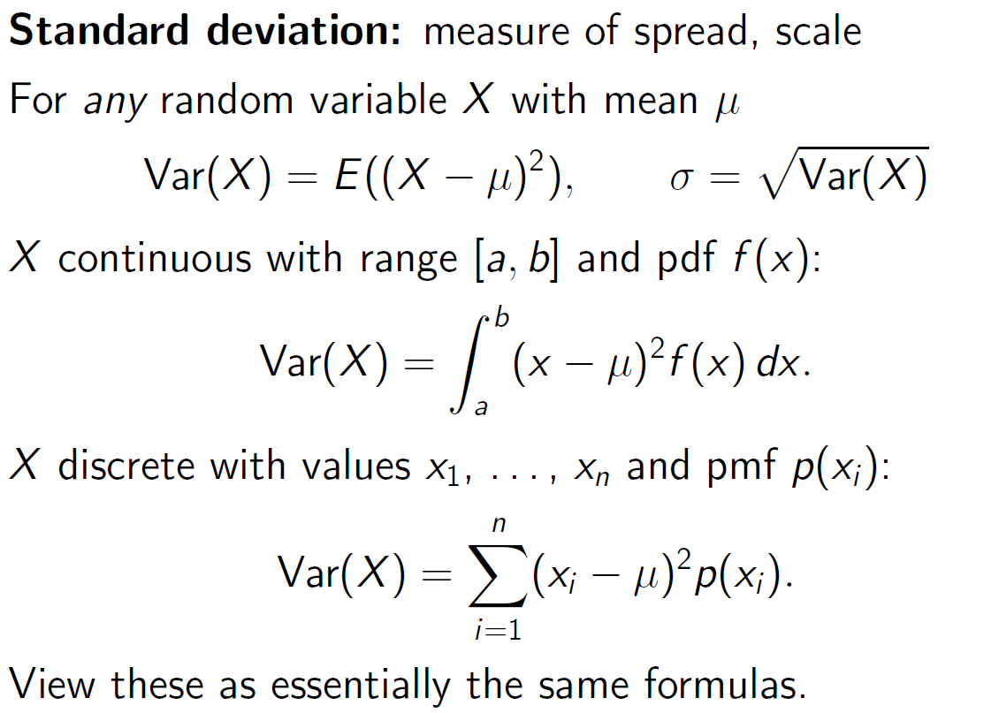

Slide 17
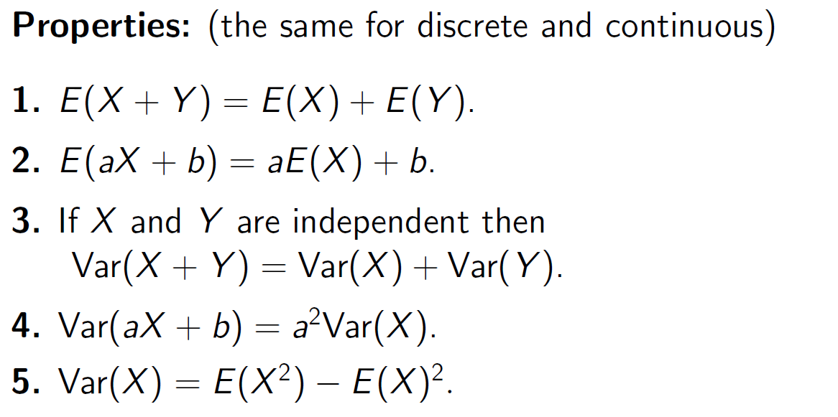

Slide 18
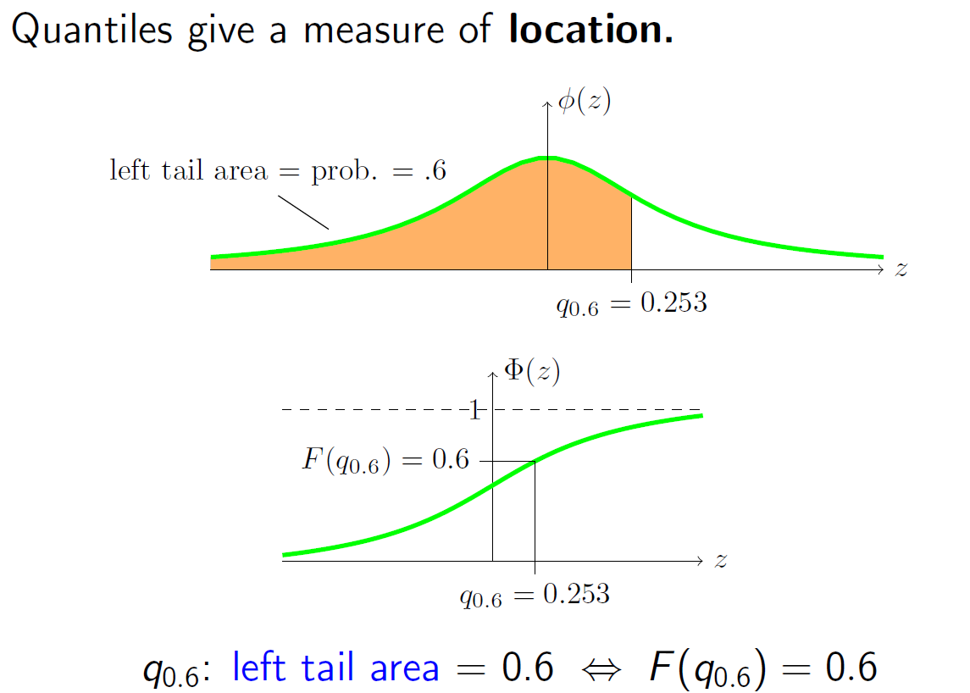
Standard Normal pdf
Median is the 0.5 Quantile (q_{0.5}).
Standard Normal cdf

Slide 19
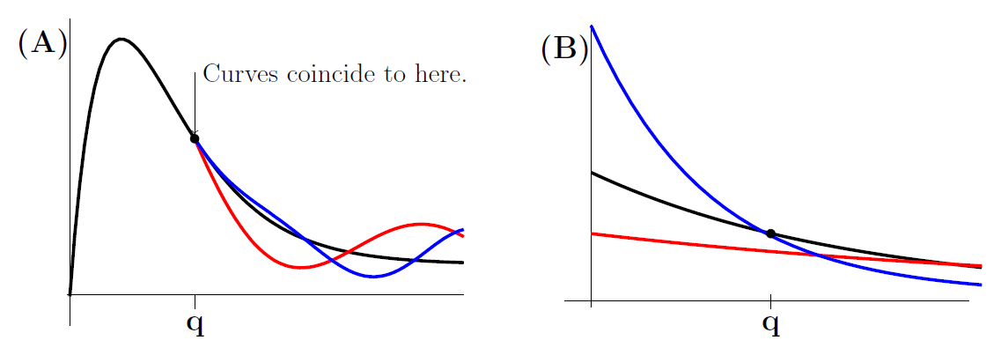
Question
Each of the curves is the pdf for a given random variable.
The median of the black plot is always at q.
Which density has the greatest median?
1. Black 2. Red 3. Blue
4. All the same 5. Impossible to tell

Slide 20
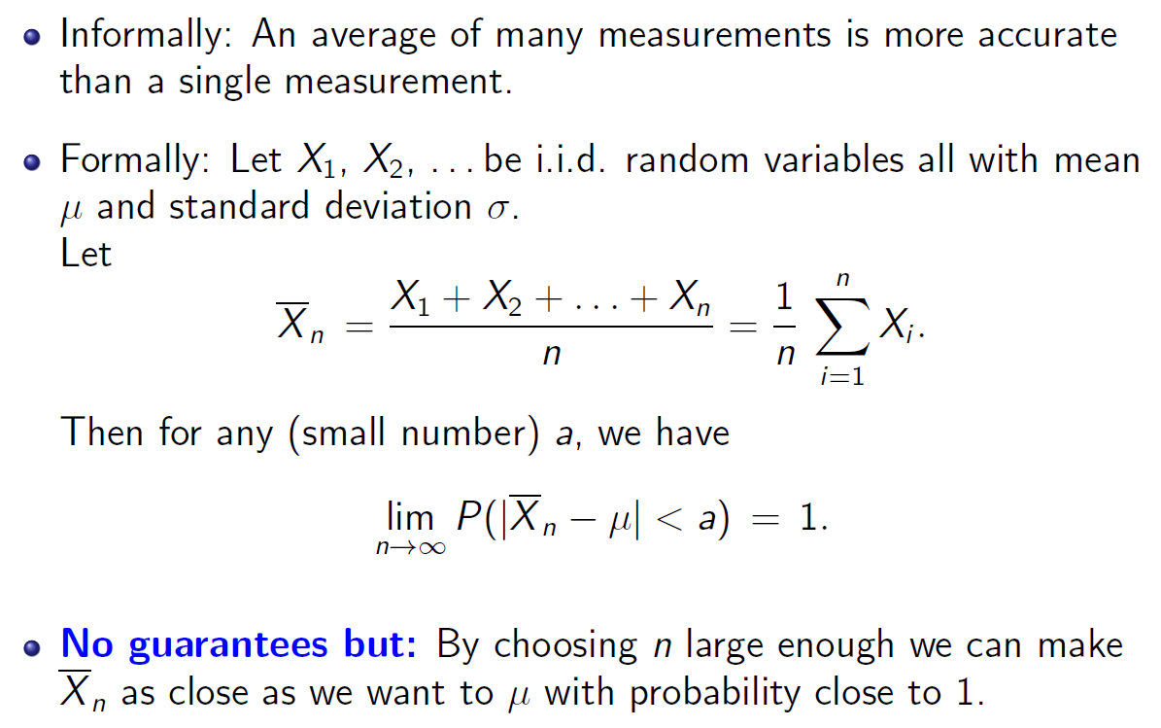
Law of Large Numbers

Slide 21
Question
You have $10000. If you bet $k, you either win $k with probability p or lose $k with probability 1 − p.
Maximal strategy: Bet as much as you can, up to what you need, each time.
Minimal strategy: Make a small bet, say $5, each time.
1. If p = 0.45, which is the better strategy?
(a) Maximal (b) Minimal (c) They are the same
2. If p = 0.8, which is the better strategy?
(a) Maximal (b) Minimal (c) They are the same

